Slide 1
HarvestGuard: Leaf Disease Classification
Presented By:
Lauren Taylor, Prachi Khanna, Ryan Laxamana

Slide 2
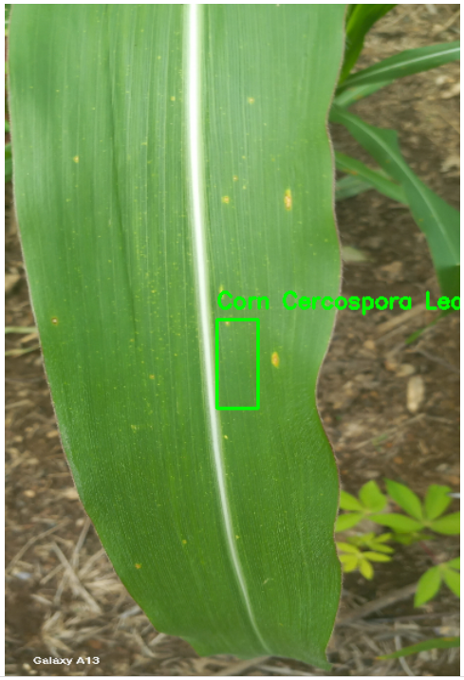
Introduction
Project Overview:
Multi-class object detection and bounding box regression system
Aims to identify classes of diseases on leaves and draw bounding boxes on affected areas.
Crop Disease (Ghana) Dataset is used to design the system.
Why is this problem important?
Crop disease contributes to economic loss and hunger globally.
Dynamic issue that is always evolving.
Solution
HarvestGuard aims to tackle the challenge of classifying leaf diseases in crops
Facilitates efficient and scalable disease identification, empowering farmers to respond promptly to specific issues affecting their crops

Slide 3
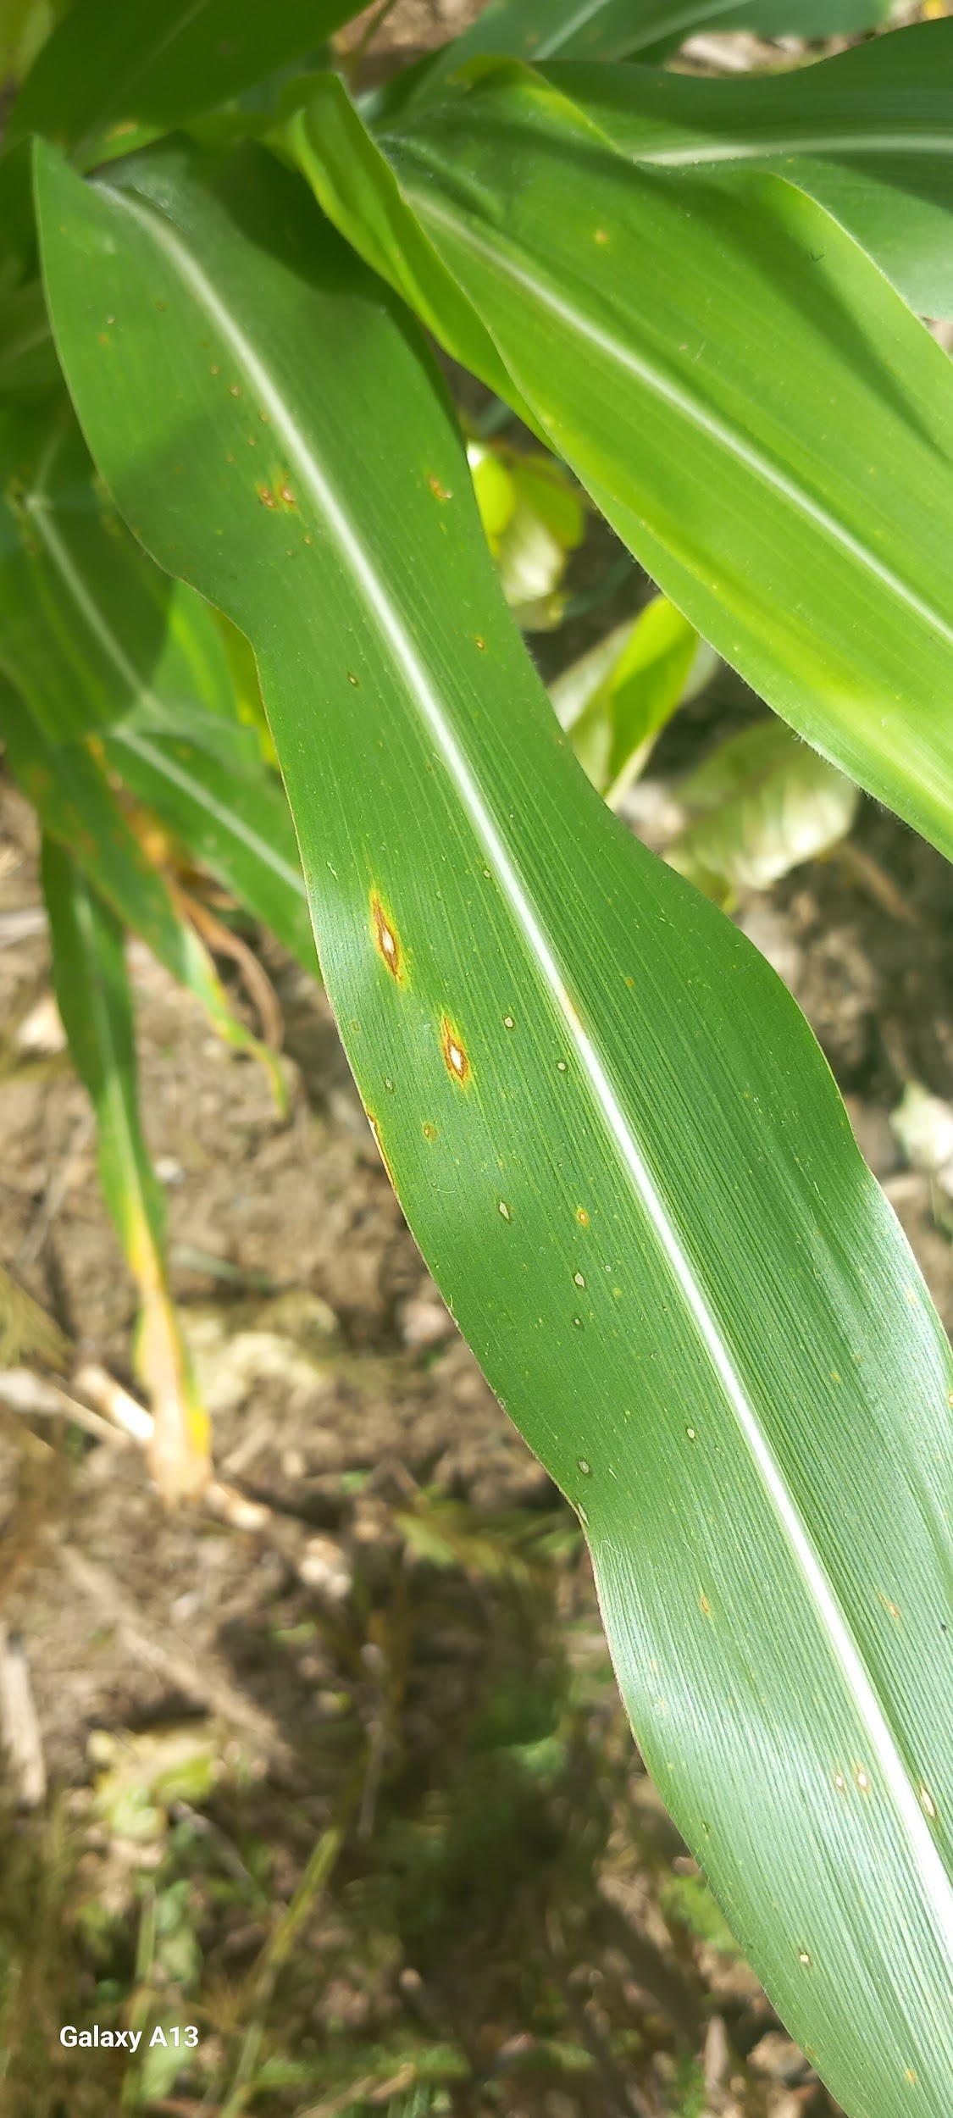
The Dataset
Crop Disease (Ghana) Dataset:
The dataset was created and published by a research group at Kwame Nkrumah University of Science and Technology in Ghana
3 crop types: (tomato, pepper, and corn)
Includes instances of various diseases, along with healthy specimens.
Annotations: Coordinates of bounding boxes encompassing diseased areas

Slide 4
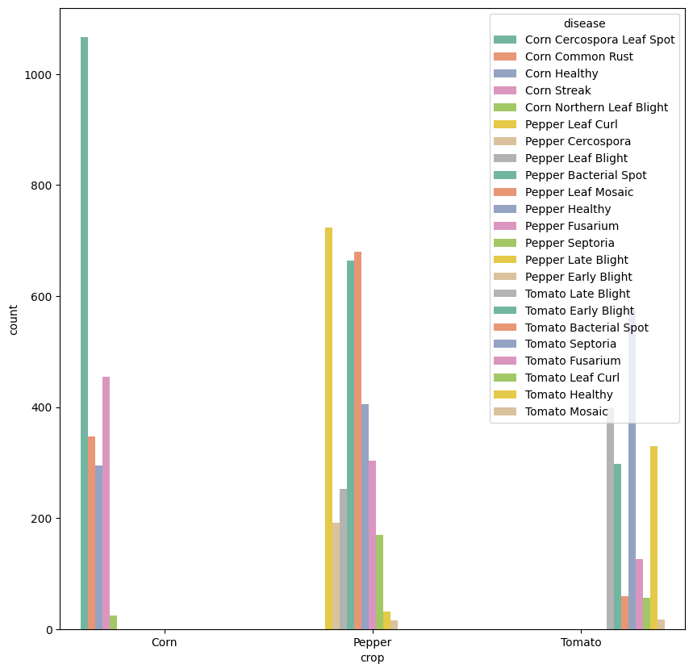
EDA/Data Augmentation
Imbalanced distribution of disease classes.
Can cause model to be biased towards more common classes.
Addressing Imbalance:
Merge similar classes, (eg. late blight and early blight→ blight)
Drop extremely rare classes or those with multiple diseases (mosaic).
Undersampling majority classes.
Data augmentation: Flipping, rotating, blurring, adding noise to images →modified bounding box coordinates

Slide 5
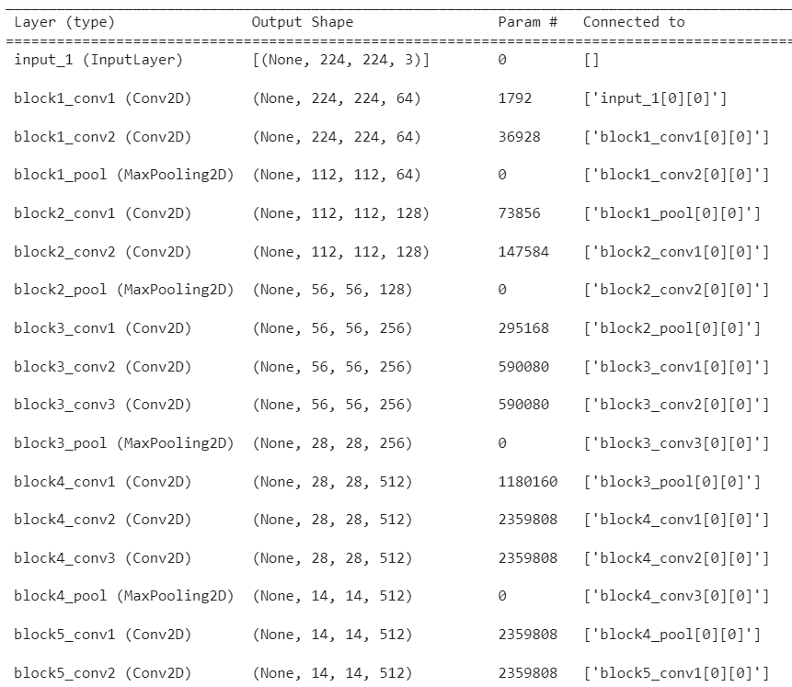
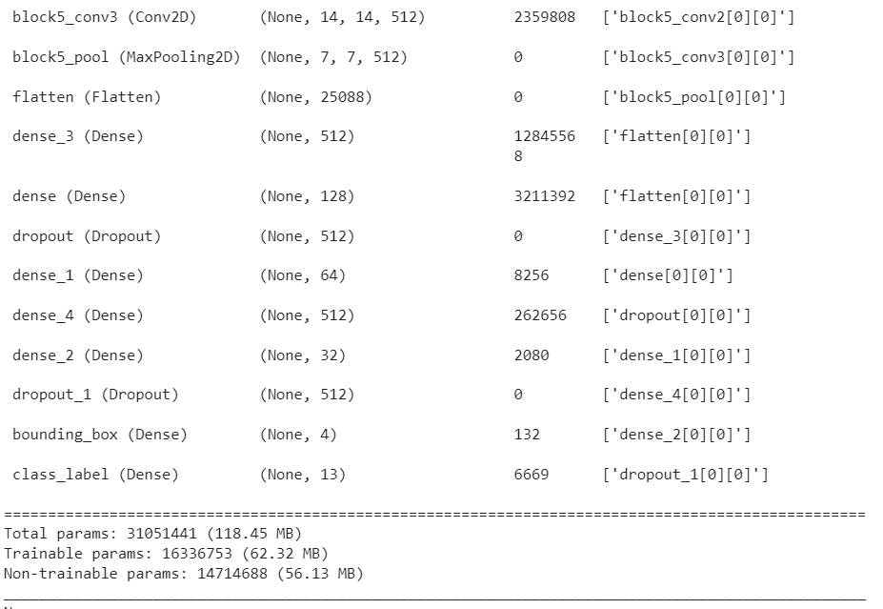
Multi-class object detection and bounding box regression
Model -
Build model for object detection and classification
Use VGG16 as pre-trained model
Construct new fully connected layer with 2 branches
Branch 1 – Regression Layer for bounding box prediction
Branch 2 – Class label prediction
Build FC head on VGG16

Slide 6
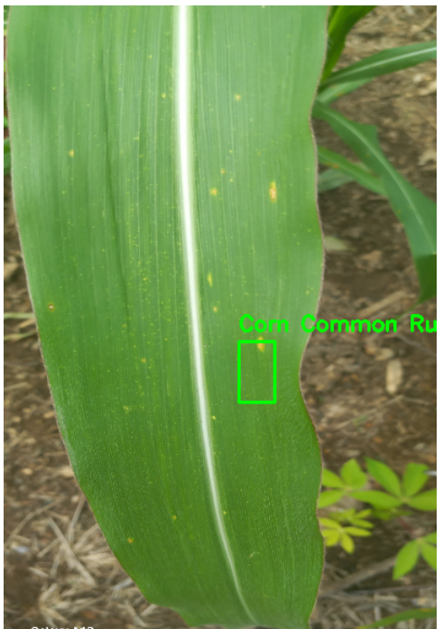
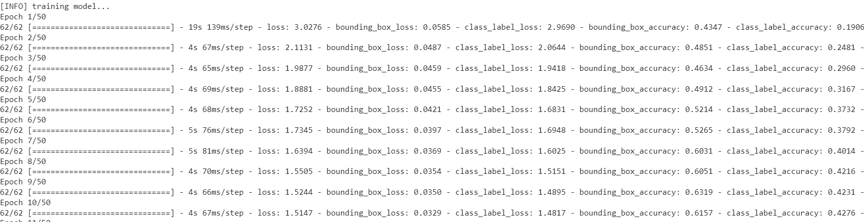
Fine-Tuning on the Crop Dataset
Model Training -
Resize images to 244*244 to input in VGG16
Converting it to a Numpy array and scaling the pixel intensities to the range [0, 1]
Training Model
Model prediction

Slide 7
HarvestGuard Overall Architecture
Data Processing
Training Loop
Crop Disease Dataset
EDA
Training Arguments
Fine Tuned Multi-Class Model
Results Prediction
Image Augmentation
Trainer
VGG16
Images and bounding boxes resizing
Evaluation

Slide 8
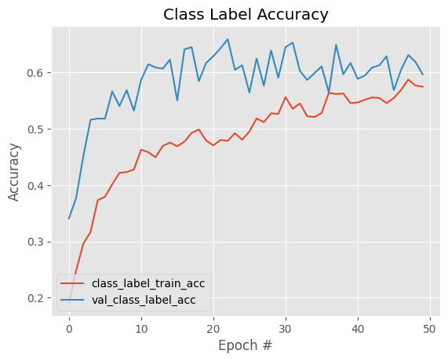
The Results-Classification Model
Metric | Value
Accuracy | 59.7%
Precision (Micro) | 63.9%
Recall (Micro) | 59.7%
F1 Score (Micro) | 59.7%
Higher Precision, lower recall →slight tendency towards false negatives
Evidence of model under fitting

Slide 9
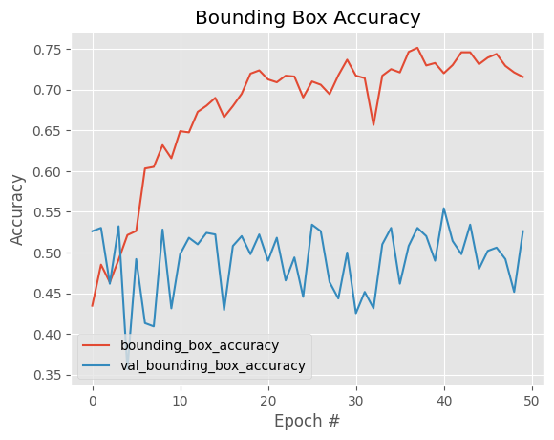
The Results-Bounding Boxes
Metric | Value
Accuracy | 52.62%
Mean Squared Error | 6.53%
Evidence of model overfitting
Instability in validation performance

Slide 10
Future Directions
Dataset concerns:
Increase data set size by collecting more photos, ensuring categorical balance.
Feature Extraction:
Research architectures that can better extract subtle differences within crop types.
Regional Functionality Enhancement:
Consider souring crop samples from other regions to improve regional performance.
Explore transfer learning opportunities.
Deployment Considerations:
How to scale model to enable efficient processing of large volumes of data.
Integrating the model into existing farming systems.
Updating system as problem evolves and new knowledge becomes available.

Slide 11
Individual Contributions
Lauren:
Data Preprocessing
Data augmentation
Writing report
Creating slides
Prachi:
Design model
Training model
Model evaluation
Creating slides
Writing report
Ryan:
Writing Report

Slide 12
References
Food and Agriculture Organization of the United Nations. (2017). The future of food and agriculture: Trends and challenges. Rome. Retrieved from http://www.fao.org/3/a-i6583e.pdf
Savary, S., Willocquet, L., Pethybridge, S. J., Esker, P., McRoberts, N., & Nelson, A. (2019). The global burden of pathogens and pests on major food crops. Nature Ecology & Evolution, 3(3), 430-439. https://doi.org/10.1038/s41559-018-0793-y
Kumar, A., & Jain, A. (2019). Plant disease classification using image processing and machine learning. Procedia Computer Science, 132, 377-384. https://doi.org/10.1016/j.procs.2018.05.218
Rail Lab, Kwame Nkrumah University of Science and Technology. (n.d.). Responsible AI Lab. Retrieved from https://rail.knust.edu.gh/
Simonyan, K., & Zisserman, A. (2014). Very deep convolutional networks for large-scale image recognition. arXiv preprint arXiv:1409.1556.
Russakovsky, O., Deng, J., Su, H., Krause, J., Satheesh, S., Ma, S., ... & Berg, A. C. (2015). ImageNet large scale visual recognition challenge. International Journal of Computer Vision, 115(3), 211-252. https://doi.org/10.1007/s11263-015-0816-y
Szegedy, C., Vanhoucke, V., Ioffe, S., Shlens, J., & Wojna, Z. (2016). Rethinking the inception architecture for computer vision. In Proceedings of the IEEE conference on computer vision and pattern recognition (pp. 2818-2826). https://doi.org/10.1109/CVPR.2016.308

